Slide 1
BATTLEFIELD BASKETBALL OFFICIALS' ASSOCIATION
2024 – 2025 SEASON
WELCOME MEETING

Slide 2
INTRODUCTIONS – New Members
Please share:
Your Name
An overview of your officiating experience (if any)
What you are most excited about this season
Anything else you’d like to share

Slide 3
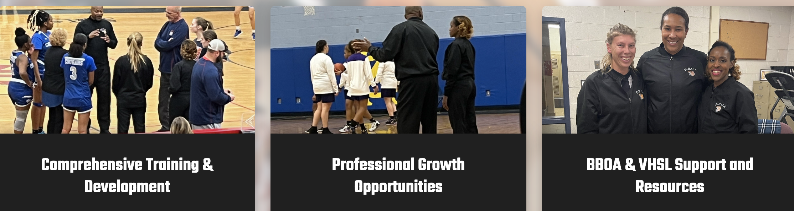
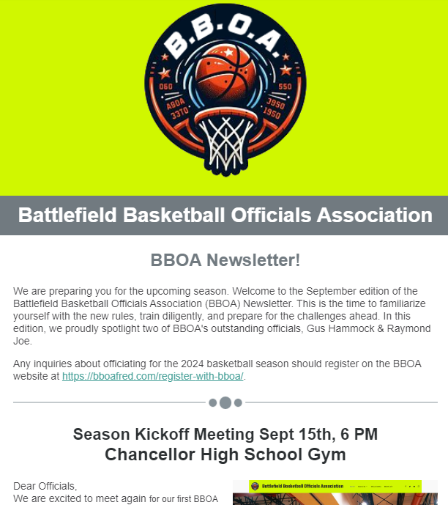
OFF SEASON ACCOMPLISHMENTS
Enhancements
BBOA Website
BBOA Newsletter
Stafford County Public Schools contract
extended through 2026-2027 season
New contract with Spotsylvania Parks & Recreation

Slide 5
NEW THIS SEASON
Establishment of 5 Committees & 2 Training Leads
3 New Programs
Mentor
Evaluation
Referral
Business Documents
Independent Contractor Agreement
Code of Professionalism, Conduct, & Ethics
Pledge of Service

Slide 6
COMEES
COMMITTEES TRAINING
Advisory
Chris Call
Darryl Shamble
Assigning
Les Bullock
Raymond Joe
Tiffany Daniels
Jillian Franklin
William Johnson
Training
John Lambert
Lorondo Ashworth
Rick Walton
William Johnson
Recruiting
Annette Mitchell
Charles Thomas
Darnell Ector
Gus Hammock
Evaluation
Gary Taylor
Harvey Jones
John Lambert
Keith Armstrong
Larondo Ashworth
Rick Watson
William Johnson
Game Management & Basketball 101
John Lambert
Rules & Mechanics
Rick Watson
Committee Lead

Slide 7
MENTOR PROGRAM
Guidance & direction to new officials
Promote individual development
Official base & succession planning
Future BBOA leaders

Slide 8
EVALUATION PROGRAM
Tier-ranking system
Evaluation elements
Timing of evaluations
Evaluating officials

Slide 9
REFERRAL PROGRAM
Direct referrals to www.bboafred.com
Ensure your referee knows to list your name as the referral source
Get paid! Referral fee is earned when the new official completes the season officiating a minimum of 15 games and is in good standing
1st referral = $50 membership credit
Additional referrals = $25 credit
3+ referrals = $50 bonus
5+ referrals = $150 bonus

Slide 10
Independent Contractor Agreement
An independent contractor agreement helps both parties establish a clear, mutually agreed-upon framework for their working relationship.
Provides clarity and structure - scope of work, relationship of parties, payment terms, etc.
Specifies the responsibilities and expectations of both parties.
Terms and conditions under which the BBOA and contractor will operate.
Clarifies the contractor's status - important for tax purposes.
Clauses related to confidentiality and intellectual property rights.

Slide 11
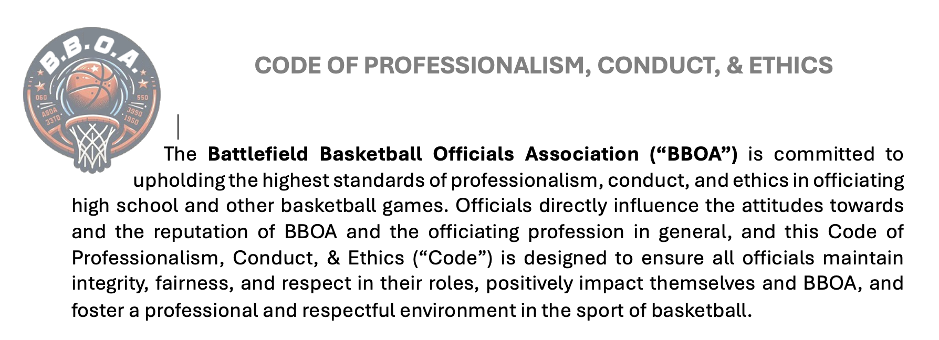
CODE OF PROFESSIONALISM, CONDUCT & ETHICS

Slide 12
CODE OF PROFESSIONALISM, CONDUCT & ETHICS
Professionalism
Respect & Courtesy
Communication
Appearance
Decision-making, etc.
Ethics
Honesty
Gifts/Benefits
Confidentiality
Conflicts of Interest, etc.
Conduct
Preparing for games
Pre- and Post-game
Punctuality
On the Court
Knowledge
Mechanics
Decision-making, etc.

Slide 13
Pledge of Service
BBOA’s Commitment to its membership
Respect & Recognition
Fair Compensation
Support & Resources
Timing of Scheduling
Safe & Positive Environment
Professional Development
Open & Timely Communication

Slide 14
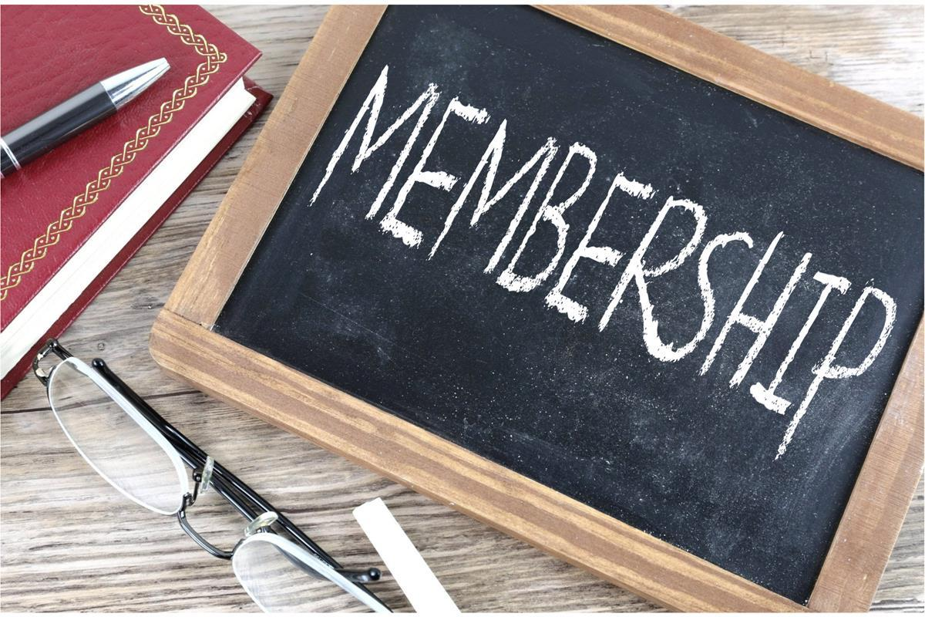
BBOA MEMBERSHIP
BBOA Membership Dues - $50
Deducted from pay
Members receive rule book, official manual, training, & swag bag
Social event

Slide 15
VHSL REGISTRATION
VHSL Registration: www.whistle.vhsl.org
$45 – paid by official at time of registration
Includes liability insurance coverage
Next Steps (More to come)
VHSL Rules Clinic
“Understanding VHSL Policy” video
Complete the corresponding test

Slide 16
BBOA’s officiating software of record
www.arbitersports.com
Remember to:
Ensure your profile/account information is accurate
Keep your availability updated
Block any conflicts of interest

Slide 17
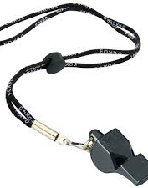
PAY
Varsity
(3 man)
$100/game
Varsity
(2 man)
$105/game
Freshman/JV
$85/game
Middle School
$77/game
Spotsy/Stafford/Fred'bg Parks & Rec
2 man - $50/game
1 man - $54/game
YMCA
$45/game

Slide 18
PRE-GAME/GAME DAY PROTOCALS
Confirm game attendance with partner no later than 24 hours in advance of game time
If unable to reach partner, promptly reach out to an assignor
Arrive in a timely manner
Varsity – 1 hour in advance
Freshman/JV – 30 minutes in advance
Middle school/Recreational – 15 minutes in advance
Be ready and on the floor 15 minutes in advance of game time

Slide 19
GAME TURNBACKS
General
The earlier notice, the better
Have a legitimate reason
Repay in kind
> 72 hours or more from game time
24 - 72 hours from game time
< 24 hours from game time
No show or notice is after 12 pm on game day
$2
$5
Fines
$25
Game Fee

Slide 20
GAME ARRIVAL & DEPARTURE DRESS CODE
Business casual
No athletic wear such as shorts, sweat suits, sneakers, jeans, or sandals
Exception: Officials may arrive in uniform to private, middle and Parks & Rec games (no place to change)

Slide 21
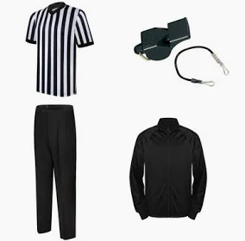
GAME DRESS CODE
VHSL black and white striped shirt w/ flag patch
Solid black athletic shoes
Pleated or flat beltless black pants
Fox 40 whistle w/ black lanyard
Black jacket w/ BBOA logo
No jewelry (except wedding band)

Slide 22
PRE-SEASON CHECK
Uniforms & equipment
Rules
Mechanics
Mental fitness
Physical fitness
Are you ready?

Slide 23
DATES TO REMEMBER
Varsity Fall League
Wednesdays
September 18th – October 23rd

Slide 24
QUESTIONS ?

